Slide 1
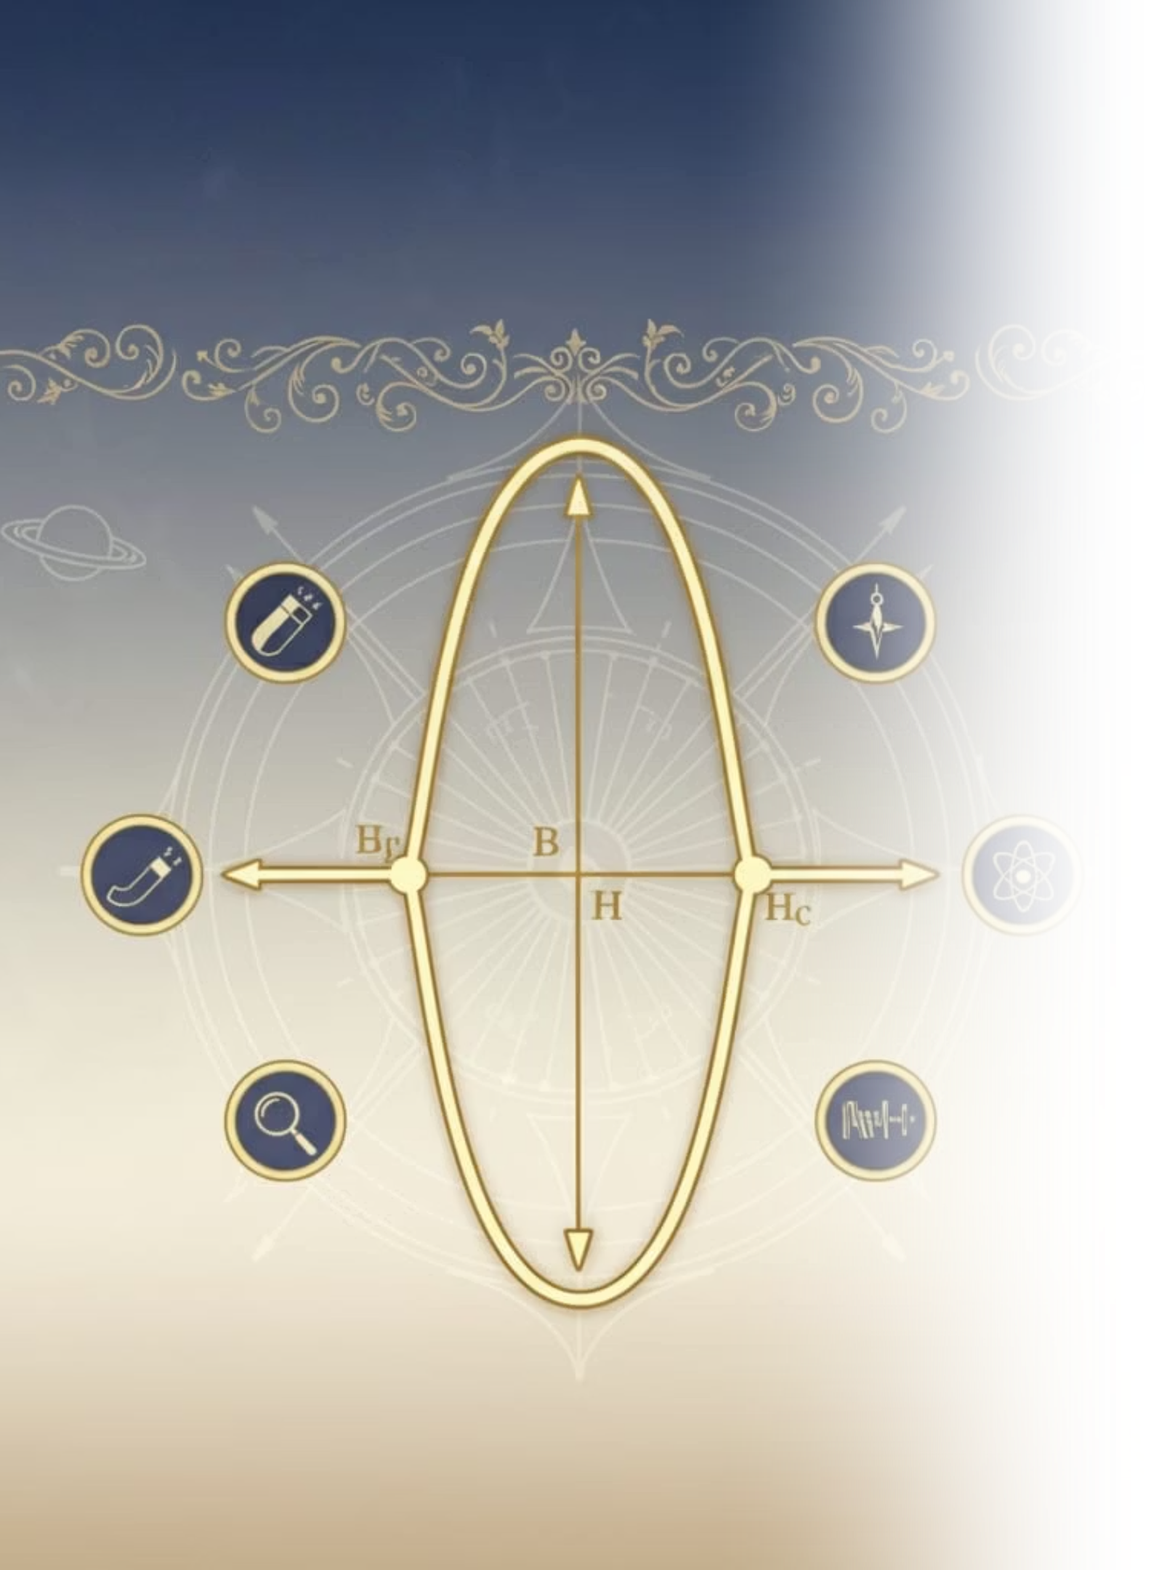
B-H Curve of a Ferromagnetic material
Understanding material response and energy loss.
-Abdul Baseer:25R11A66A3
-M.Adhithya Vardan: 25R11A66A4

Slide 2

Ferromagnetic Material
Magnetization
Residual Magnetism
It is a material which can be magnetized easily
The magnetization remains even in the absence of the magnetic field
Strength Dependency
Example
The strength of the magnet depends on the magnetizing field
Eg. Iron, Cobalt, Nickel etc.

Slide 3

Hysteresis
Lagging of Magnetization
It is the lagging of magnetization of a ferromagnetic material
Goes Beyond Zero
When a ferro-magnetic material is magnetized, it will not go back to zero even after the magnetizing field is removed.

Slide 4







Magnetization process
Exposure
Random Domains
Domains Align
Saturation
A ferromagnetic material can be magnetized via exposure to heat, external magnetic field, rubbing of permanent magnet and electromagnetism
Initially, Domains are randomly oriented
As Magnetization Power (H) increases, domains align in the direction of the field
Magnetization rises quickly at first, then saturates.

Slide 5


Aim of the experiment
Study the B-H curve characteristics
Analyze material properties
To study the properties of the magnetic material obtained/given
To study the B-H curve characteristics of a ferromagnetic material and hence

Slide 6

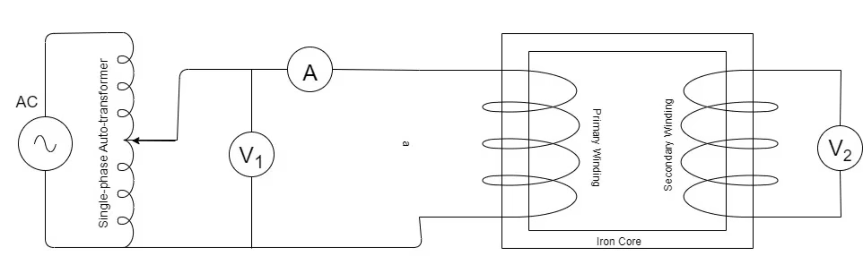
Apparatus and Circuit
Single Phase Auto Transformer (VARIAC)
Voltmeters (0-250V)
Ammeter
Connecting Wires

Slide 7

Theory and Formula
When a magneto motive force is applied to an iron ring or core, magnetic potential gradient is produced within the material.
This is expressed by H= (N \cdot I)/l
The induced EMF due to the electromagnetic coil can be represented via
Using this, we draw a graph between Current and Voltage, which is similar to the curve traced by the B-H characteristics.

Slide 8




Procedure of Experiment
Connect the Circuit
Increase Voltage in Steps
Note Readings
The circuit is connected as shown in circuit diagram
The readings of Voltmeter V2 and Ammeter are noted
Voltage is increased in Variac in steps

Slide 9
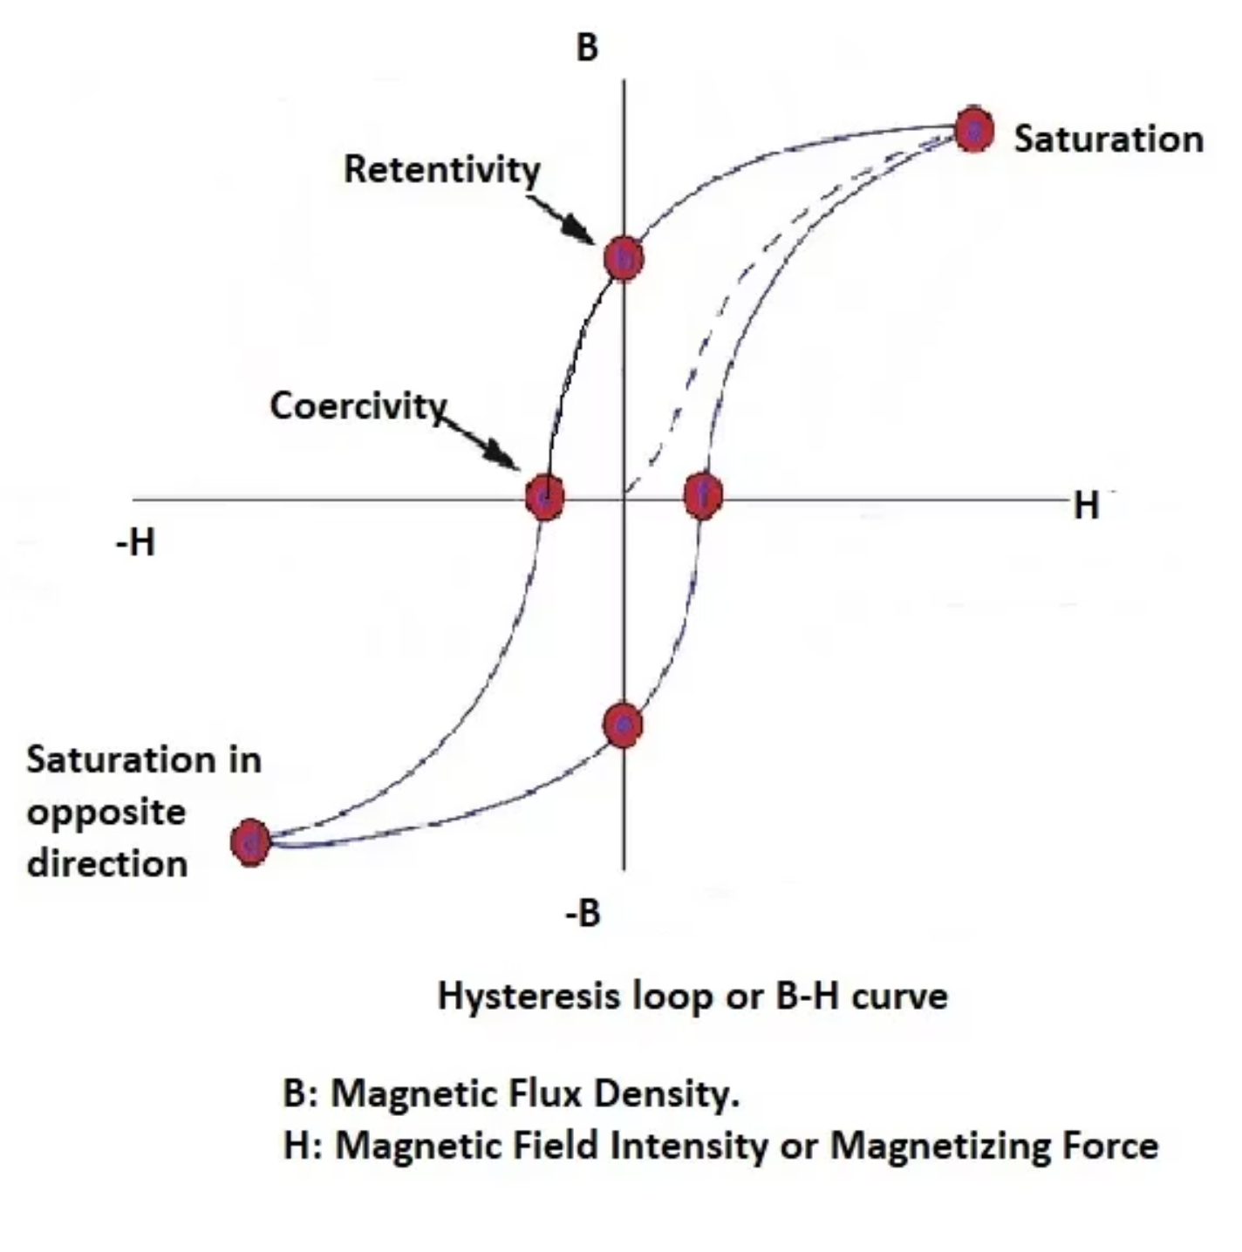

B-H Curve
HYSTERISIS LOOP
The curve formed by the B-H Characteristics is known as the "Hysteresis Loop"

Slide 10


Applications and Conclusion
Key Applications
These ferromagnetic materials are used in transformer cores, motors and electromagnets
Energy Efficiency
Understanding B-H curve helps reduce energy loss
Conclusion: Thus, B-H curve explains how ferromagnetic materials behave under varying magnetic fields

Slide 11


